Slide 1
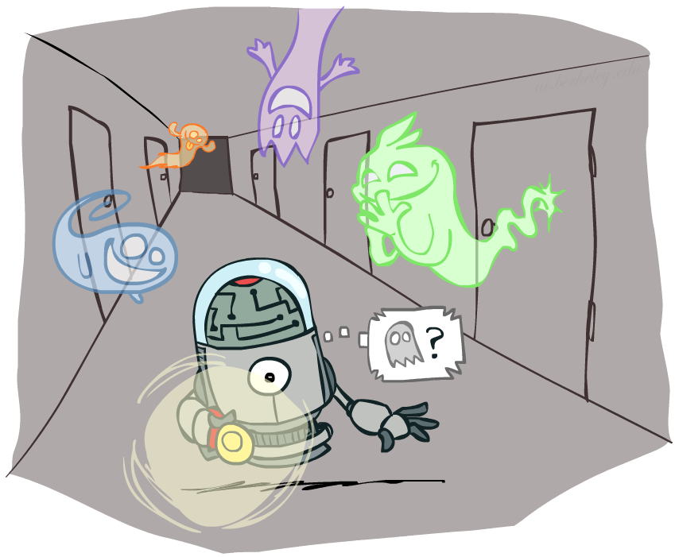
CS 370: Artificial Intelligence
Hidden Markov Models
Instructor: William DeMeo, NJIT
[These slides were created by Dan Klein and Pieter Abbeel for CS188 Intro to AI at UC Berkeley. All CS188 materials are available at http://ai.berkeley.edu.]
Notes:
Please retain proper attribution, including the reference to ai.berkeley.edu. Thanks!
Note: pretty short lecture, good one to present mini-contest results or anything else not exactly lecture.

Slide 2
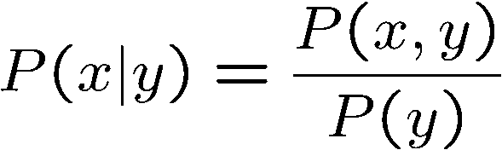
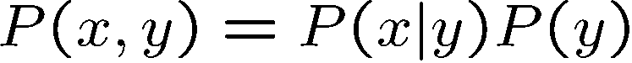
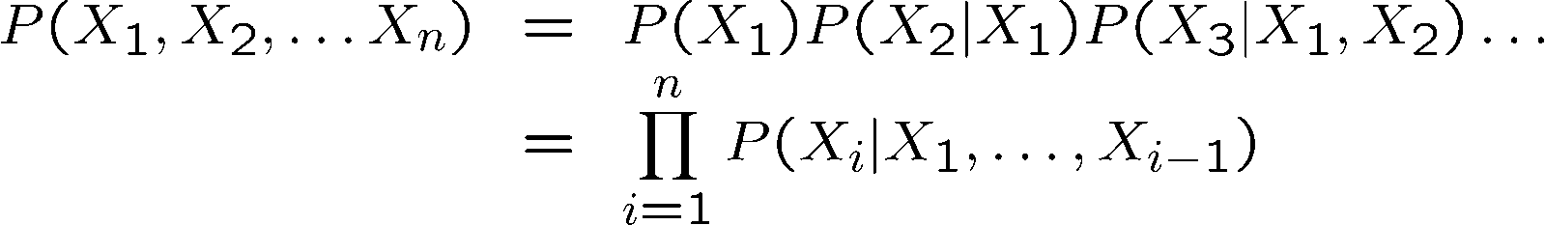
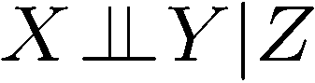
Probability Recap
Conditional probability
Product rule
Chain rule
X, Y independent if and only if:
X and Y are conditionally independent given Z if and only if:

Slide 3
Reasoning over Time or Space
Often, we want to reason about a sequence of observations
Speech recognition
Robot localization
User attention
Medical monitoring
Need to introduce time (or space) into our models

Slide 4
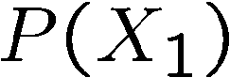
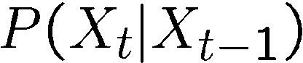
Markov Models
Value of X at a given time is called the state
Parameters: called transition probabilities or dynamics, specify how the state evolves over time (also, initial state probabilities)
Stationarity assumption: transition probabilities the same at all times
Same as MDP transition model, but no choice of action
X₁
X₂
X₃
X₄

Slide 5

Conditional Independence
Basic conditional independence:
Past and future independent given the present
Each time step only depends on the previous
This is called the (first order) Markov property
Note that the chain is just a (growable) BN
We can always use generic BN reasoning on it if we truncate the chain at a fixed length

Slide 6
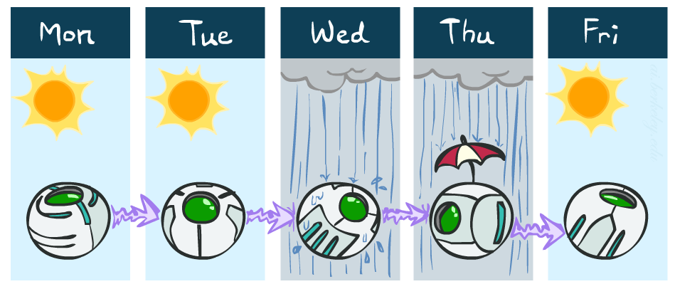
Example Markov Chain: Weather
States: X = {rain, sun}
Initial distribution: 1.0 sun
CPT P(X_{t} | X_{t-1}):
Two new ways of representing the same CPT
X_{t-1} | X_{t} | P(X_{t}|X_{t-1})
sun | sun | 0.9
sun | rain | 0.1
rain | sun | 0.3
rain | rain | 0.7
0.9
0.3
0.9
rain
sun
sun
sun
0.1
0.3
rain
rain
0.7
0.7
0.1

Slide 7
Example Markov Chain: Weather
0.9
Initial distribution: 1.0 sun
What is the probability distribution after one step?
0.3
rain
sun
0.7
0.1

Slide 8
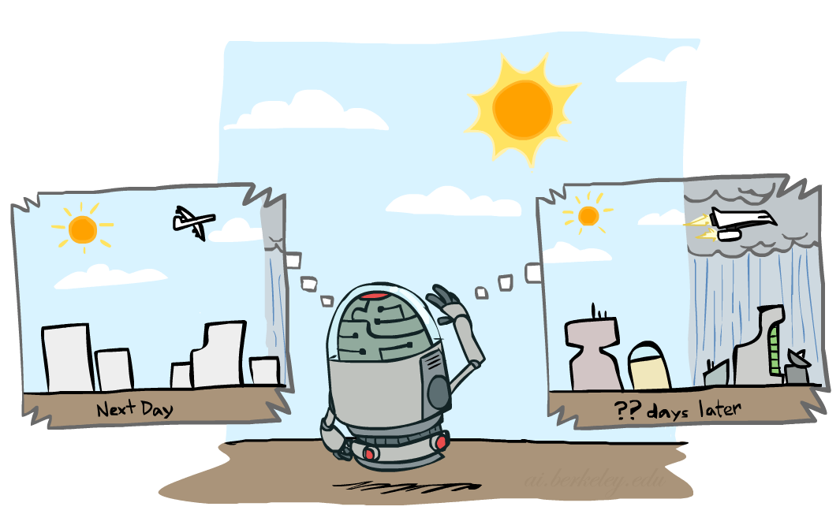

Mini-Forward Algorithm
Question: What’s P(X) on some day t?
X₁
X₂
X₃
X₄
Forward simulation

Slide 9
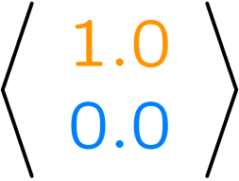
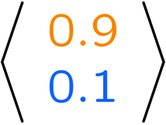
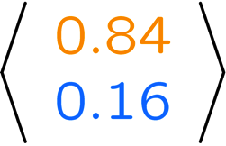
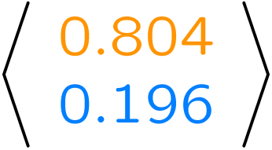
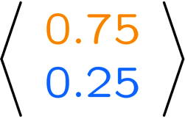
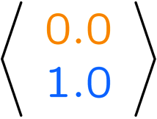
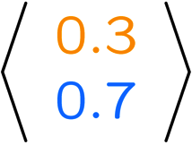
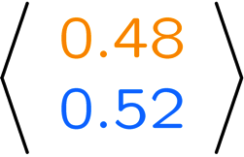
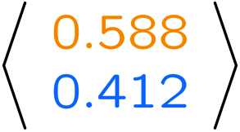
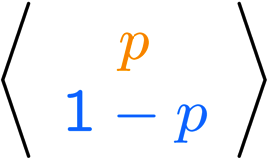
Example Run of Mini-Forward Algorithm
From initial observation of sun
From initial observation of rain
From yet another initial distribution P(X₁):
P(X₁)
P(X₂)
P(X₃)
P(X₄)
P(X∞)
P(X₁)
P(X₂)
P(X₃)
P(X₄)
P(X∞)
…
P(X₁)
P(X∞)
[Demo: L13D1,2,3]

Slide 10

Video of Demo Ghostbusters Basic Dynamics

Slide 11
Video of Demo Ghostbusters Circular Dynamics

Slide 12
Video of Demo Ghostbusters Whirlpool Dynamics

Slide 13

Stationary Distributions
For most chains:
Influence of the initial distribution gets less and less over time.
The distribution we end up in is independent of the initial distribution
Stationary distribution:
The distribution we end up with is called the stationary distribution of the chain
It satisfies

Slide 14
Example: Stationary Distributions
Question: What’s P(X) at time t = infinity?
X₁
X₂
X₃
X₄
X_{t-1} | X_{t} | P(X_{t}|X_{t-1})
sun | sun | 0.9
sun | rain | 0.1
rain | sun | 0.3
rain | rain | 0.7
Also:

Slide 15

Application of Stationary Distribution: Web Link Analysis
PageRank over a web graph
Each web page is a state
Initial distribution: uniform over pages
Transitions:
With prob. c, uniform jump to a
random page (dotted lines, not all shown)
With prob. 1-c, follow a random
outlink (solid lines)
Stationary distribution
Will spend more time on highly reachable pages
E.g. many ways to get to the Acrobat Reader download page
Somewhat robust to link spam
Google 1.0 returned the set of pages containing all your keywords in decreasing rank, now all search engines use link analysis along with many other factors (rank actually getting less important over time)
Notes:
Before: most search engines were merely based on how well a page matches your search words.
Note: currently dominated by clickstreams

Slide 16

Application of Stationary Distributions: Gibbs Sampling*
Each joint instantiation over all hidden and query variables is a state: {X₁, …, X_{n}} = H U Q
Transitions:
With probability 1/n resample variable X_{j} according to
P(X_{j} | x₁, x₂, …, x_{j-1,} x_{j+1}, …, x_{n,} e_{1,} …, e_{m})
Stationary distribution:
Conditional distribution P(X₁, X₂ , … , X_{n}|e_{1,} …, e_{m})
Means that when running Gibbs sampling long enough we get a sample from the desired distribution
Requires some proof to show this is true!
Notes:
With re-ordering of topics, can’t cover this here yet, need to wait till after sampling.

Slide 17

Hidden Markov Models

Slide 18
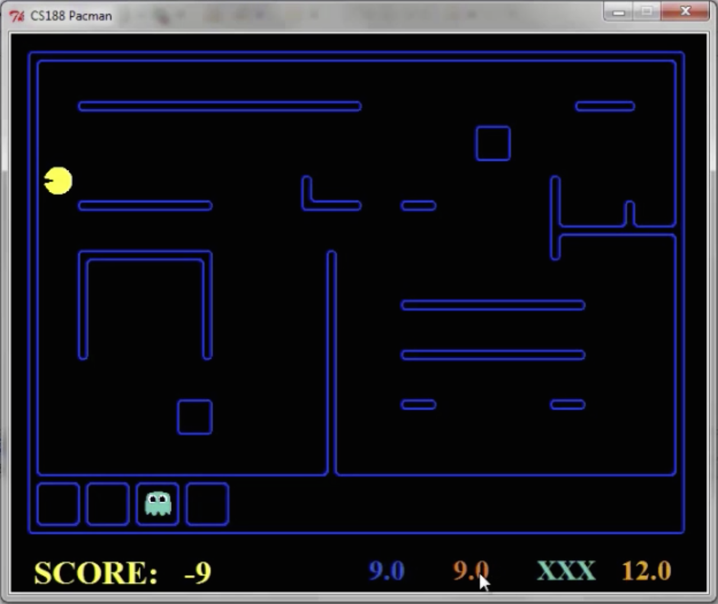
Pacman – Sonar (P4)
[Demo: Pacman – Sonar – No Beliefs(L14D1)]

Slide 19
Video of Demo Pacman – Sonar (no beliefs)

Slide 20
Hidden Markov Models
Markov chains not so useful for most agents
Need observations to update your beliefs
Hidden Markov models (HMMs)
Underlying Markov chain over states X
You observe outputs (effects) at each time step
X₁
X₂
X₃
X₄
X₅
E₁
E₂
E₃
E₄
E₅

Slide 21


Example: Weather HMM
Rain_{t-1}
Rain_{t}
Rain_{t+1}
Umbrella_{t-1}
Umbrella_{t}
Umbrella_{t+1}
An HMM is defined by:
Initial distribution:
Transitions:
Emissions:
R_{t-1} | R_{t} | P(R_{t}|R_{t-1})
+r | +r | 0.7
+r | -r | 0.3
-r | +r | 0.3
-r | -r | 0.7
R_{t} | U_{t} | P(U_{t}|R_{t})
+r | +u | 0.9
+r | -u | 0.1
-r | +u | 0.2
-r | -u | 0.8
Notes:
demo

Slide 22


Example: Ghostbusters HMM
P(X₁) = uniform
P(X|X’) = usually move clockwise, but sometimes move in a random direction or stay in place
P(R_{ij}|X) = same sensor model as before: red means close, green means far away.
1/9
1/9
1/9
1/9
1/9
1/9
1/9
1/9
1/9
P(X₁)
1/6
1/6
1/2
0
1/6
0
X₁
X₂
X₃
X₄
0
0
0
X₅
P(X|X’=<1,2>)
R_{i,j}
R_{i,j}
R_{i,j}
R_{i,j}
[Demo: Ghostbusters – Circular Dynamics – HMM (L14D2)]
Notes:
Dan has some demo for this.

Slide 23
Video of Demo Ghostbusters – Circular Dynamics -- HMM

Slide 24
Conditional Independence
HMMs have two important independence properties:
Markov hidden process: future depends on past via the present
Current observation independent of all else given current state
Quiz: does this mean that evidence variables are guaranteed to be independent?
[No, they tend to correlated by the hidden state]
X₁
X₂
X₃
X₄
X₅
E₁
E₂
E₃
E₄
E₅

Slide 25
Real HMM Examples
Speech recognition HMMs:
Observations are acoustic signals (continuous valued)
States are specific positions in specific words (so, tens of thousands)
Machine translation HMMs:
Observations are words (tens of thousands)
States are translation options
Robot tracking:
Observations are range readings (continuous)
States are positions on a map (continuous)

Slide 26
Filtering / Monitoring
Filtering, or monitoring, is the task of tracking the distribution B_{t}(X) = P_{t}(X_{t} | e₁, …, e_{t}) (the belief state) over time
We start with B₁(X) in an initial setting, usually uniform
As time passes, or we get observations, we update B(X)
The Kalman filter was invented in the 60’s and first implemented as a method of trajectory estimation for the Apollo program
Notes:
Dan has some demo for this

Slide 27
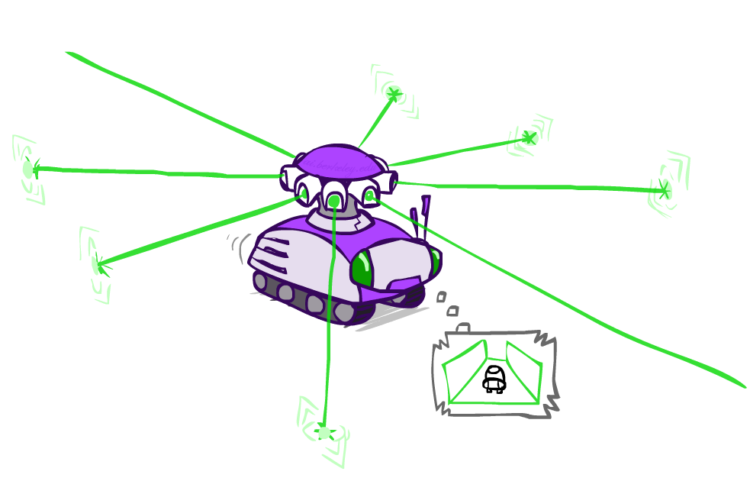
Example: Robot Localization
Example from Michael Pfeiffer
Prob
0
1
t=0
Sensor model: can read in which directions there is a wall, never more than 1 mistake
Motion model: may not execute action with small prob.

Slide 28
Example: Robot Localization
Prob
0
1
t=1
Lighter grey: was possible to get the reading, but less likely b/c required 1 mistake

Slide 29
Example: Robot Localization
Prob
0
1
t=2

Slide 30
Example: Robot Localization
Prob
0
1
t=3

Slide 31
Example: Robot Localization
Prob
0
1
t=4

Slide 32
Example: Robot Localization
Prob
0
1
t=5

Slide 33
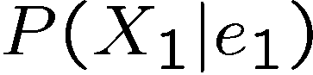
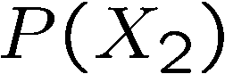
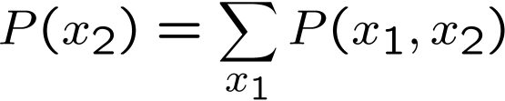
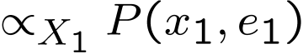
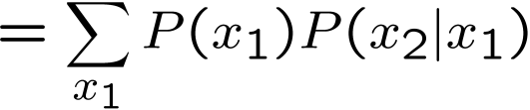
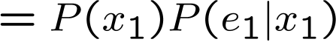
Inference: Base Cases
X₁
X₁
X₂
E₁

Slide 34
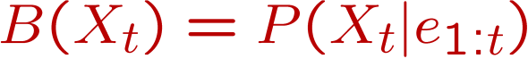
Passage of Time
Assume we have current belief P(X | evidence to date)
Then, after one time step passes:
Basic idea: beliefs get “pushed” through the transitions
With the “B” notation, we have to be careful about what time step t the belief is about, and what evidence it includes
X₁
X₂
Or compactly:
Notes:
TODO: intermediate step in derivation!

Slide 35

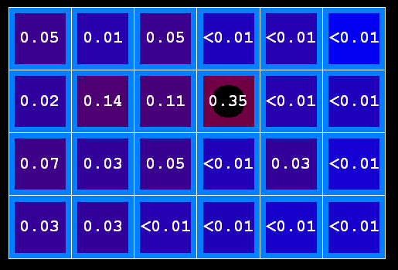
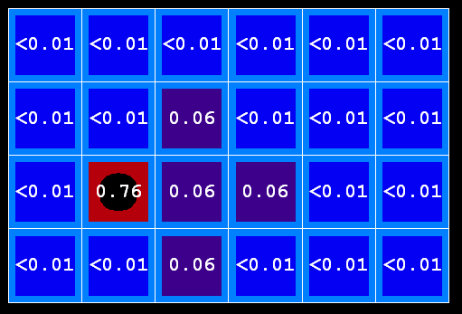
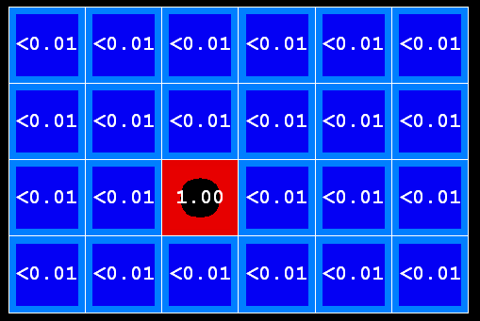
Example: Passage of Time
As time passes, uncertainty “accumulates”
(Transition model: ghosts usually go clockwise)
T = 1
T = 2
T = 5

Slide 36
Observation
X₁
Assume we have current belief P(X | previous evidence):
Then, after evidence comes in:
Or, compactly:
E₁
Basic idea: beliefs “reweighted” by likelihood of evidence
Unlike passage of time, we have to renormalize
Notes:
Basic idea: beliefs “reweighted” by likelihood of evidence
Unlike passage of time, we have to renormalize

Slide 37



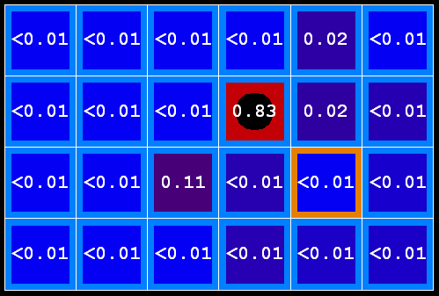
Example: Observation
As we get observations, beliefs get reweighted, uncertainty “decreases”
Before observation
After observation

Slide 38
Example: Weather HMM
B’(+r) = 0.5
B’(-r) = 0.5
B’(+r) = 0.627
B’(-r) = 0.373
B(+r) = 0.5
B(-r) = 0.5
B(+r) = 0.818
B(-r) = 0.182
B(+r) = 0.883
B(-r) = 0.117
Rain₀
Rain₁
Rain₂
R_{t} | R_{t+1} | P(R_{t+1}|R_{t})
+r | +r | 0.7
+r | -r | 0.3
-r | +r | 0.3
-r | -r | 0.7
R_{t} | U_{t} | P(U_{t}|R_{t})
+r | +u | 0.9
+r | -u | 0.1
-r | +u | 0.2
-r | -u | 0.8
Umbrella₁
Umbrella₂
Notes:
demo

Slide 39
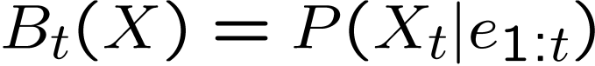
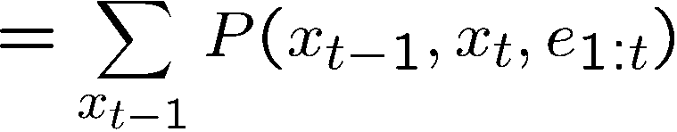
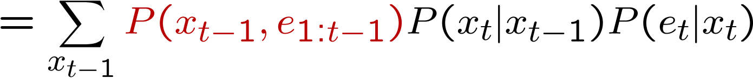
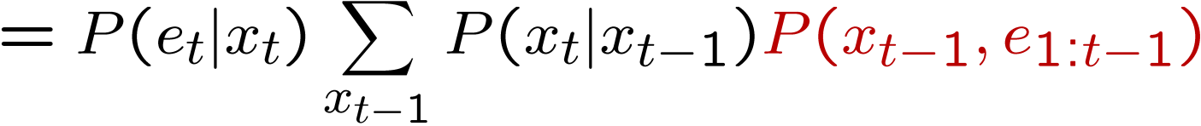
The Forward Algorithm
We are given evidence at each time and want to know
We can derive the following updates
We can normalize as we go if we want to have P(x|e) at each time step, or just once at the end…
Notes:
TODO: explain propto and it’s X_t, not X

Slide 40
Online Belief Updates
Every time step, we start with current P(X | evidence)
We update for time:
We update for evidence:
The forward algorithm does both at once (and doesn’t normalize)
X₁
X₂
X₂
E₂

Slide 41
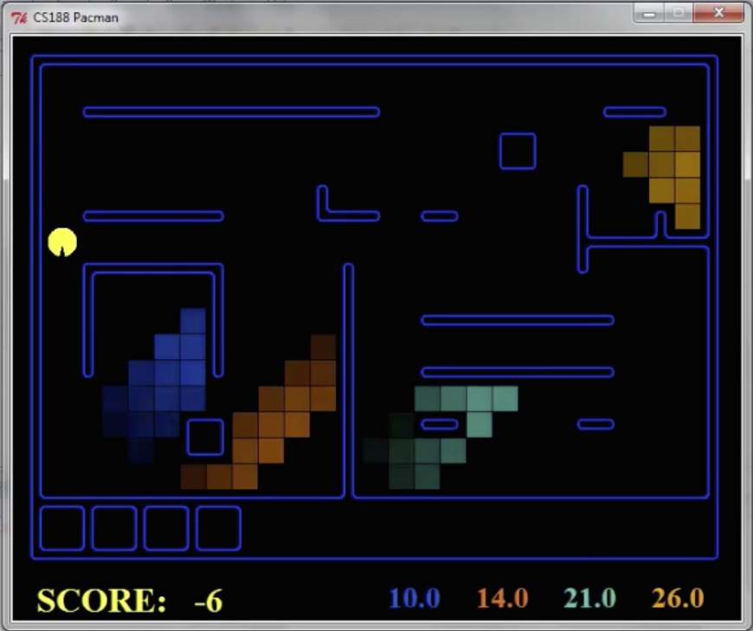
Pacman – Sonar (P4)
[Demo: Pacman – Sonar – No Beliefs(L14D1)]

Slide 42
Video of Demo Pacman – Sonar (with beliefs)

Slide 43
Next Time: Particle Filtering and Applications of HMMs

